Slide 1
Grid Computing Systems: A Survey and Taxonomy
Material for this lecture from:
“A Survey and Taxonomy of Resource Management Systems for Grid Computing Systems, K. Krauter, R. Buyya, M. Maheswaran, CS Technical Report.

Slide 2
Introduction
Network Computing System:
  a virtual system that is formed by machines and networks that agree to work together by pooling their resources
Grid is a generalized network computing system that is supposed to scale to Internet levels and handle data and computation seamlessly

Slide 3
Introduction
Resource management in Grid systems involves managing the basic elements
Grid elements:
  processing elements: uniprocessors, multiprocessors, handhelds, ..
  storage elements:
  network elements:

Slide 4
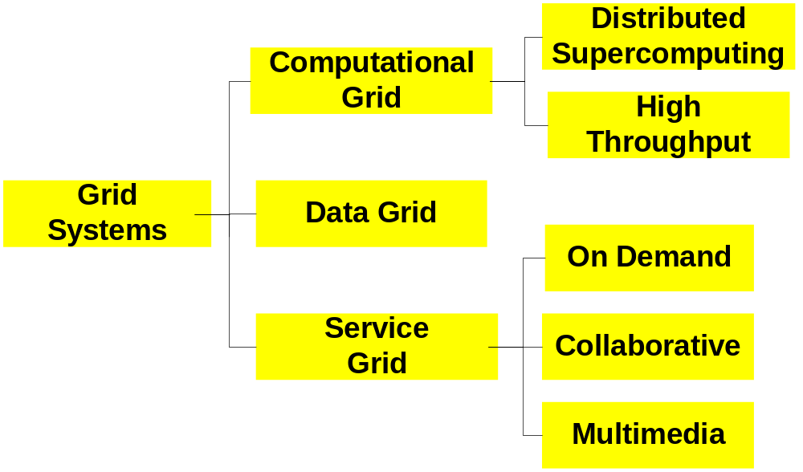
Introduction
Grid systems can be classified depending on their usage:

Slide 5
Introduction
Computational Grid:
  denotes a system that has a higher aggregate capacity than any of its constituent machine
  it can be further categorized based on how the overall capacity is used
Distributed Supercomputing Grid:
  executes the application in parallel on multiple machines to reduce the completion time of a job

Slide 6
Introduction
Grand challenge problems typically require a distributed supercomputing Grid – one of the motivating factors of early Grid research – still driving in some quarters
High throughput Grid:
  increases the completion rate of a stream of jobs arriving in real time
  ASIC or processor design verifications tests would be run on a high throughput Grid

Slide 7
Introduction
Data Grid:
  systems that provide an infrastructure for synthesizing new information from data repositories such as digital libraries or data warehouses
  applications for these systems would be special purpose data mining that correlates information from multiple different high volume data sources

Slide 8
Introduction
Service Grid:
  systems that provide services that are not provided by any single machine
  subdivided based on the type of service they provide
collaborative Grid:
  connects users and applications into collaborative workgroups -- enable real time interaction between humans and applications via a virtual workspace

Slide 9
Introduction
Multimedia Grid:
  provides an infrastructure for real time multimedia applications -- requires the support quality of service across multiple different machines whereas a multimedia application on a single dedicated machine can be deployed without QoS
  synchronization between network and end-point QoS

Slide 10
Introduction
demand Grid:
  category dynamically aggregates different resources to provide new services
  data visualization workbench that allows a scientist to dynamically increase the fidelity of a simulation by allocating more machines to a simulation would be an example

Slide 11
Abstract Model for a Grid RMS
resource to refer to the entities that are managed by the RMS and jobs to refer to the entities that utilize resources
architectures of existing resource management systems are quite different
an abstract model of resource management systems provides a basis for a comparison between different RMS architectures

Slide 12
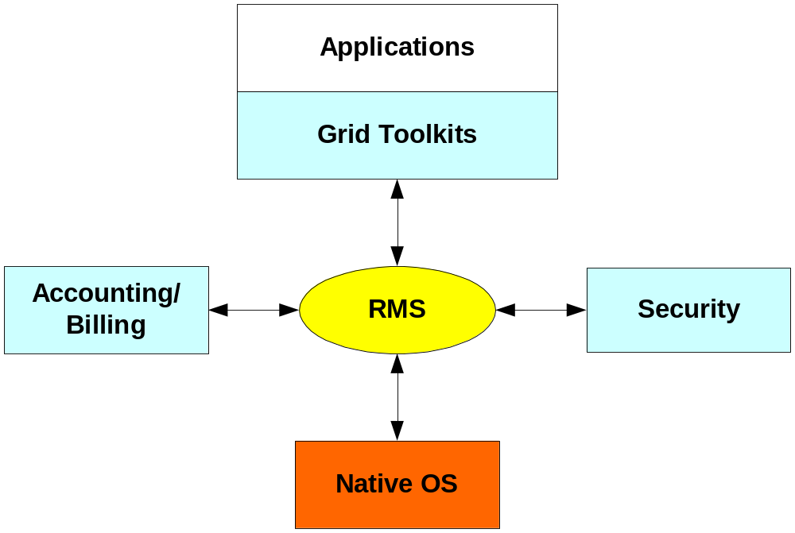
Abstract Model for a Grid RMS

Slide 13
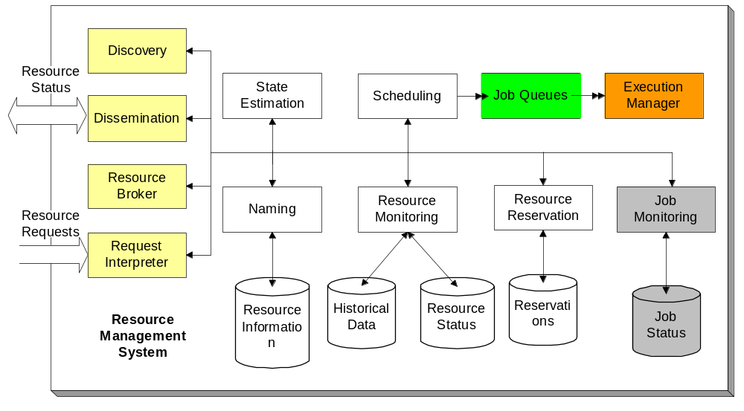
Abstract Model for a Grid RMS

Slide 14
Abstract Model for a Grid RMS
three different types of functional units:
  application to RMS interfaces
  RMS to native operating system and hardware environment
  internal RMS functions
application to RMS interfaces provides services that end-user or Grid applications use to carry out their work
RMS to native operating system or hardware environment interface provides the mechanisms that the RMS uses to implement resource management functions

Slide 15
Abstract Model for a Grid RMS
internal RMS functions identify the functions that are implemented as part of providing the resource management service
resource dissemination, resource discovery, resource broker and request interpreter function provide the application to RMS interfaces
RMS to native operating system interfaces are provided by the execution manager, job monitoring, and resource monitoring functions

Slide 16
Abstract Model for the RMS
internal RMS functions are provided by the resource naming, scheduling, resource reservation and state estimation
Resource information is distributed between machines in the Grid using a resource information protocol
This protocol is implemented by the resource and dissemination functions
Application resource requests are described using a resource description language or protocol that is parsed by the resource interpreter into the internal formats used by the other RMS functions

Slide 17
Abstract Model for the RMS
The resource dissemination function and resource discovery function provide the means by which machines within the Grid are able to form a view of the available resources and their state
resource naming function is an internal function that enforces the namespace rules for the resources and maintains a database of resource information
The structure, content, and maintenance of the resource database are important differentiating factors between different RMS

Slide 18
Abstract Model for the RMS
naming function interacts with the resource dissemination, discovery, and request interpreter so design choices in the namespace significantly affect the design and implementation of these other functions
flat namespace would impose a significantly higher level of messaging between machines in the Grid even with extensive caching

Slide 19
Abstract Model for the RMS
request interpreter accepts requests for resources, they are turned into jobs that scheduled and executed by the internal functions in the RMS
job queue abstracts the implementation choices made for scheduling algorithms
scheduling function examines the jobs queue and decides the state of the jobs in the queue

Slide 20
Abstract Model for the RMS
The scheduling function uses the current information provided by the job status, resource status, and state estimation function to make its scheduling decisions
scheduling function examines the jobs queue and decides the state of the jobs in the queue
The scheduling function uses the current information provided by the job status, resource status, and state estimation function to make its scheduling decisions

Slide 21
Abstract Model for the RMS
state estimation uses the current state information and a historical database to provide information to the scheduling algorithm
execution manager does not control the execution of the jobs on a machine other than initiating the job using the native operating system services

Slide 22
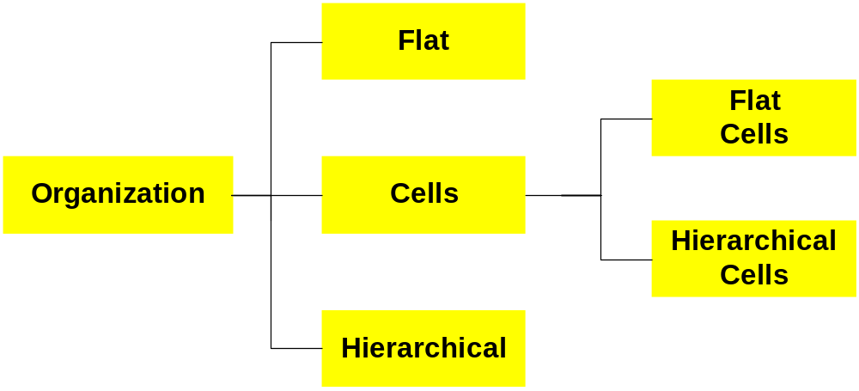
Machine Organization
Traditionally machines were organized as either in a centralized or decentralized organization
Different classification is shown below

Slide 23
Machine Organization
flat organization all machines can directly communicate with each other without going through an intermediary -- no current Grid systems use this type of organization but previous generation systems in a cluster environment used a flat organization
hierarchal organization machines in same level can directly communicate with the machines directly above them or below them, or peer to them in the hierarchy -- most current Grid systems use this organization since it is scalable to some extent

Slide 24
Machine Organization
cell structure, the machines within the cell communicate between themselves using flat organization
designated machines within the cell function acts as boundary elements that are responsible for all communication outside the cell
internal structure of a cell is not visible from another cell, only the boundary machines are

Slide 25
Machine Organization
cells can be further organized in a flat or hierarchical structures
Grid that has a flat cell structure has only one level of cells whereas a hierarchical cell structure can have cells that contain other cells

Slide 26
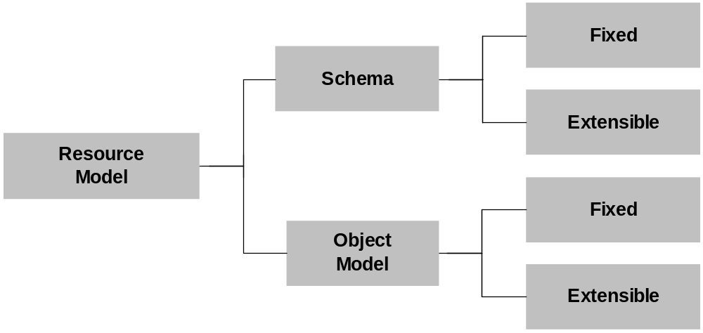
Resource Model
resource model determines how applications and the RMS describe and manage Grid resources

Slide 27
Resource Model
the resource descriptions and resource status data store are integrated with their operations in an active scheme or if they function as passive data with operations being defined by other components in the RMS
Condor “classad” approach using semi-structured data approach is in the extensible schema category

Slide 28
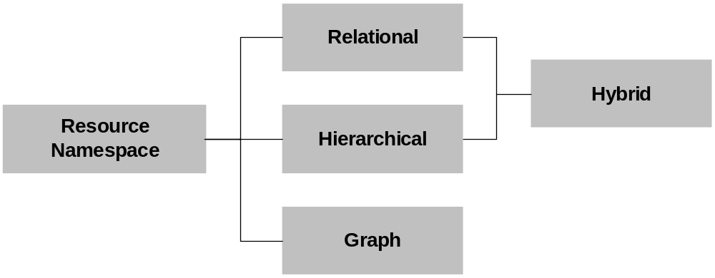
Resource Naming Model
organization of the resource namespace influences the design of the resource management protocols and affects the discovery methods

Slide 29
Resource Naming Model
flat namespace the use of agents to discover resources would require some sort of global strategy to partition the search space in order to reduce redundant searching of the same information
relational namespace divides the resources into relations and uses concepts from relational databases to indicate relationships between tuples in different relations

Slide 30
Resource Naming Model
hierarchical namespace divides the resources in the Grid into hierarchies
graph-based namespace uses nodes and pointers where the nodes may or may not be complex entities

Slide 31
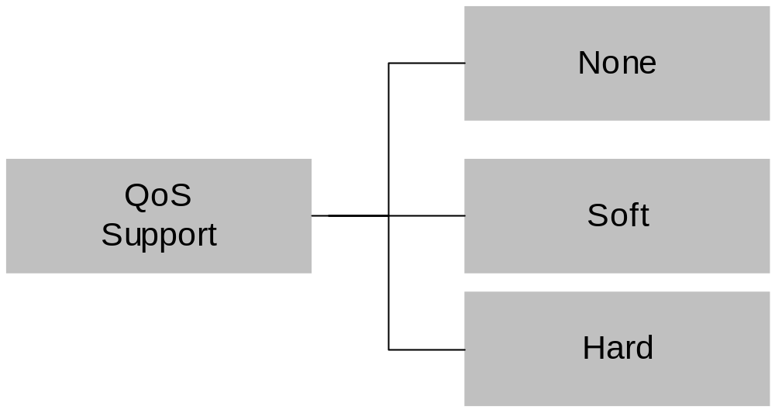
QoS Model
inefficient to guarantee network QoS and not be able to ensure the application components that are communicating over this link have performance guarantees on their respective processing elements

Slide 32
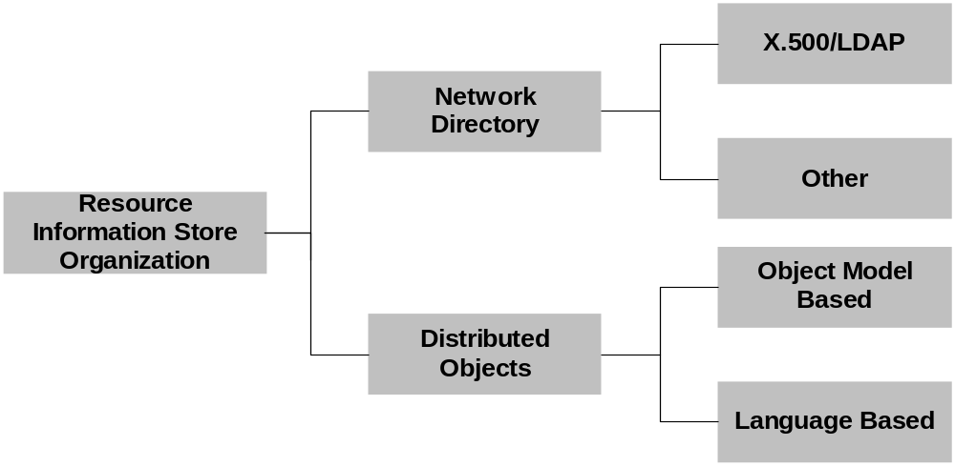
Resource Info. Store Model
organization determines the cost of implementing the resource management protocols since resource dissemination and discovery may be provided by the data store implementation

Slide 33
Resource Info. Store Model
Distributed object data stores utilize persistent object services that are provided by language independent object models such as CORBA or a language based model such as that provided by persistent Java object implementations
Network directories data stores are based on X.500/LDAP standards or utilize specialized distributed database implementation

Slide 34
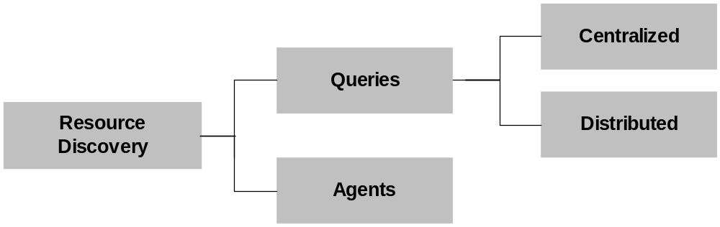
Resource Discovery Model
Network directory based systems mechanisms such as Globus MDS use parameterized queries that are sent across the network to the nearest directory, which uses its query engine to execute the query against the database contents

Slide 35
Resource Discovery Model
Query based system are further characterized depending on whether the query is executed against a distributed database or a centralized database
Agent based approaches send active code fragments across machines in the Grid that are interpreted locally on each machine

Slide 36
Resource Dissemination Model
Universal awareness:
  Each node has complete awareness of the entire system
Neighborhood awareness:
  Each node is aware of nodes that lie within a predefined network vicinity
Distinctive awareness:
  Each node is aware of nodes within a vicinity and are also aware of nodes outside that vicinity if they are “important”

Slide 37
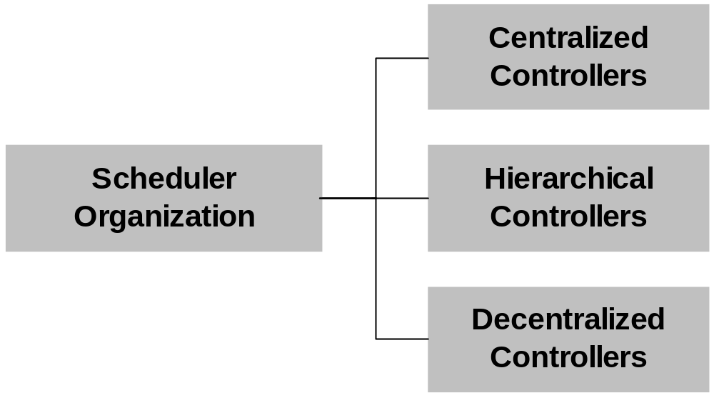
Scheduler Organization Model

Slide 38
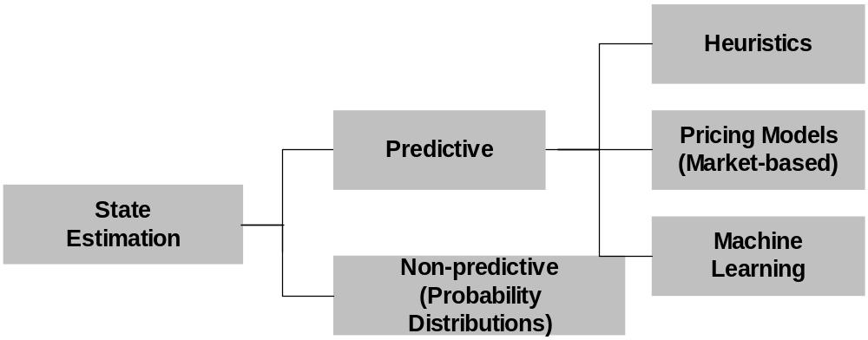
State Estimation Model

Slide 39
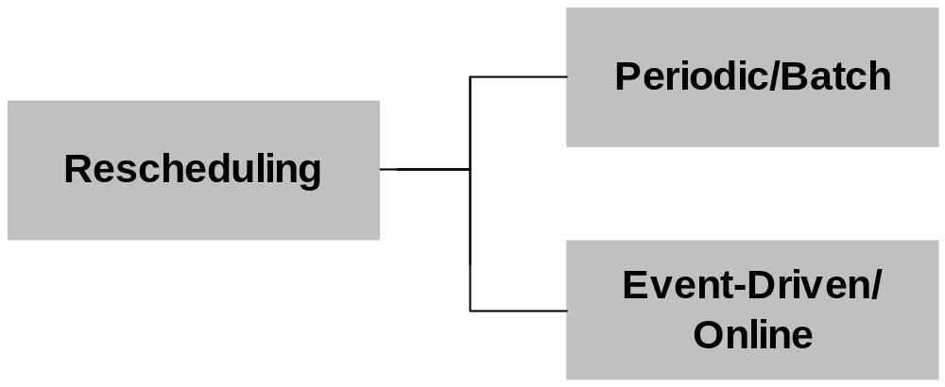
Rescheduling Model

Slide 40
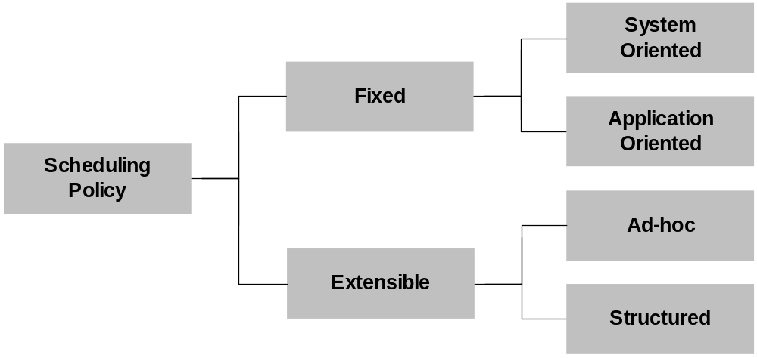
Scheduling Policy

